Slide 1

Atrial Fibrillation Detection using Machine Learning Domain: Machine Learning
Project Guide:
Dr. P. Seethalakshmi
Batch Members:
Kowsalya S(710020106016)
Nivaashini S(710020106019)
Rashmiya J(710020106022)
Aswin Kumar S(710020106303)
DEPARTMENT OF ELECTRONICS AND COMMUNICATION ENGINEERING

Slide 2
CONTENTS
Abstract
Objectives
Literature Survey
Existing Method
Proposed Method
Block Diagram
Dataset
Methodology
Data Pre-processing
Feature Extraction
Training Phase
Testing and Validation
Real-time ECG signal
Hardware set-up
Outputs and Results

Slide 3
ABSTRACT
Atrial Fibrillation (AF) is the most common form of arrhythmia. AF is referred to as rapid heart-beat. AF is conventionally diagnosed by monitoring Electrocardiogram (ECG) signals. This method of diagnosis is time consuming for Cardiologists. In order to address this challenge many Machine Learning (ML) models have been proposed. In this method proposed, the ECG signals are taken as three data-sets, one MIT-BIH dataset from Physio net for training the model. The dataset is pre-processed and from this pre-processed signal, features of ECG are extracted using the Convolutional Neural Network (CNN) algorithm. The extracted features are trained to the model using the U- NET model. This trained model helps in detecting if patients are affected by Atrial Fibrillation. The other two datasets are used in predicting if the patients are affected by Atrial Fibrillation. Testing this at an early stage of AF (Paroxysmal AF) reduces the risk for life. This method is aimed to achieve an accuracy of 96.89% and F1 score of 0.969.

Slide 4
OBJECTIVES
Develop a Machine Learning model for automatic detection of Atrial Fibrillation (AF) episodes in ElectroCardioGram (ECG) recordings using Convolutional Neural Network (CNN).
Train the machine learning model using a dataset taken from ECG recordings.
Maximize accuracy and F1 score in identifying AF episodes from ECG data by minimizing the convolutional layers.

Slide 5
LITERATURE SURVEY
S.NO. | PAPER NAME | AUTHOR NAME | PUBLISHED YEAR | ALGORITHM USED | DATASET | IDE PLATFORM | ACCRACY
1. | Semi-Supervised Learning for Automatic Atrial Fibrillation Detection in 24-Hour Holter Monitoring https://ieeexplore.ieee.org/document/9772345 | Peng Zhang , Member, IEEE, Yuting Chen, Fan Lin , Sifan Wu, Xiaoyun Yang , and Qiang Li | 2022 | CNN, LSTM | Long term dynamic 12-lead ECG recordings collected from 1000 patients with paroxysmal AF from the Cardiac Function Examination Center | Python | 97.9%
2. | Novel Density Poincare Plot Based Machine Learning Method to Detect Atrial Fibrillation from Premature Atrial/Ventricular Contractions https://pubmed.ncbi.nlm.nih.gov/32746035/ | Syed Khairul Bashar, Student Member, IEEE, Dong Han, Student Member, IEEE, Fearass Zieneddin, Eric Ding, Timothy P. Fitzgibbons, Allan J. Walkey, David D. McManus, Bahram Javidi, Fellow, IEEE and Ki H. Chon | 2020 | SVM, RF | MIMIC III Waveform, wearable armband ECG data and the Physionet AFPDB | Python | 91.93%
3. | Detection of Atrial Fibrillation from Variable-Duration ECG Signal Based on Time-Adaptive Densely Network and Feature Enhancement Strategy https://ieeexplore.ieee.org/document/9946392 | X. Zhang, M. Jiang, K. Polat, A. Alhudhaif, J. Hemanth and W. Wu | 2020 | CNN | MIT-BIH Atrial Fibrillation, Physionet Atrial Fibrillation | Python | 87.98%
4. | DDCNN: A Deep Learning Model for AF Detection From a Single-Lead Short ECG Signal https://ieeexplore.ieee.org/document/9832485 | Zhaocheng Yu, Junxin Chen , Senior Member, IEEE, Yu Liu, Yongyong Chen, Tingting Wang | 2022 | CNN, LSTM | MIT-BIH database from physio net | Python | 93%

Slide 6
EXISTING METHOD
In the Existing Methods to detect Atrial Fibrillation, several Machine Learning methods and Deep Learning Models were proposed.
Existing methods has algorithms such as Convolutional Neural Networks(CNN) with Long-Short Term Memory (LSTM), CNN, Recurrent Neural Network (RNN), Support Vector Machine (SVM) and Random Forest (RF).
Existing CNN architecture with U–Net Model has about “41 Layers” with an accuracy of 96% and F1 score of 0.95.

Slide 7
PROPOSED METHOD
In the method proposed,
Data set is pre-processed
ECG Signal Segmentation
U-Net Model Training
Testing and Validation
Decision taken is AF detected or Normal Rhythm
In the proposed method the layers of the U-Net model is reduced enough yet produce equivalent accuracy and to reduce the time of processing of large ECG data signal.

Slide 8
BLOCK DIAGRAM (Training)
Data-Set
(MIT-BIH Atrial Fibrillation)
Pre-processing and Segmentation of Dataset
Feature Extraction using CNN
Training Model
(CNN U – Net)
Performance Metrics Calculation
Testing and Validation

Slide 9
BLOCK DIAGRAM (Detection)
Data-Set
(Long Term Atrial Fibrillation)
Pre-processing and Segmentation of Dataset
Atrial Fibrillation Detected or Normal Rhythm Detected
Trained U-Net Model
Data-Set
(Normal Sinus Rhythm)

Slide 10
DATASET
Dataset for Training the Model:
The dataset used is MIT-BIH Atrial Fibrillation Database.
This includes 25 long-term ECG recordings of human beings with AF. Of these, 23 records include the two ECG signals (in the .dat files); records 00735 and 03665 are represented only by the rhythm (.atr) and unaudited beat (.qrs )annotation files.
The individual recordings are each 10 hours in duration, and contain two ECG signals each sampled at 250 samples per second with 12-bit resolution over a range of ±10 millivolts.

Slide 11
DATASET
Dataset for Detection:
1. LONG TERM AF DATABASE:
This database includes 84 long-term ECG recordings of subjects with paroxysmal or sustained atrial fibrillation (AF). Each record contains two simultaneously recorded ECG signals digitized at 128 Hz with 12-bit resolution over a 20 mV range; record durations vary but are typically 24 to 25 hours.
2. MIT-BIH NORMAL SINUS RHYTHM DATABASE:
This database includes 18 long-term ECG recordings of subjects referred to the Arrhythmia Laboratory at Boston's Beth Israel Hospital. The recordings, spanning 10-hour intervals, capture two ECG signals sampled at 250 samples per second with 12-bit precision, encompassing a range of ±10 millivolts.

Slide 12
METHODOLOGY
Data Preprocessing: Raw ECG signals are pre-processed to remove noise, baseline wander, and other artifacts that may interfere with the detection of atrial fibrillation.
Feature Extraction: A CNN architecture is designed to extract relevant features directly from pre-processed ECG signals. The CNN consist of multiple layers, including convolutional layers for feature extraction and pooling layers for dimensionality reduction.
Training Phase: The CNN is trained using a dataset of annotated ECG recordings, where atrial fibrillation labels are provided. We have employed supervised learning techniques to optimize the CNN parameters and learn discriminative features for atrial fibrillation detection.
Testing and Validation: The trained CNN is evaluated using a separate test dataset to assess its performance in detecting atrial fibrillation. Performance based on accuracy is calculated to quantify the system's diagnostic capability.

Slide 13
DATA-PREPROCESSING
The preprocessing phase of ElectroCardioGram (ECG) signals is essential for refining raw data before analysis. This phase comprises three main processes: normalization, noise removal, and segmentation.
Normalization is crucial as it standardizes the scale of different features within the ECG signal. By scaling all features to a uniform range, typically between 0 and 1, normalization ensures consistent analysis across different parts of the signal.
Noise Removal aiming to attenuate unwanted artifacts and disturbances from the ECG signal, while preserving the integrity of the ECG waveform.
Segmentation involves dividing the ECG signal into discrete cardiac cycles or segments, typically by identifying the onset and offset points of each heartbeat. Segmenting signals provide precise identification of cardiac events within the ECG waveform.

Slide 14
FEATURE EXTRACTION
Features such as R peak, R-R interval is detected and measured.
R peak detection is plotted and R-R interval is calculated.
These features are extracted using CNN layers automatically at each layer of the model.

Slide 15
TRAINING PHASE
The U-NET model, comprising 23 convolutional layers, undergoes training using patient data collected over a 10-hour monitoring period, totaling one million data points per patient.
To facilitate efficient model training, this extensive dataset is segmented into 128 smaller sections.
Following segmentation, the dataset is then partitioned into training, validation, and testing subsets. Specifically, 60% of the data is allocated for training, while 40% is split between validation and testing. Within this 40%, 20% is used for validation, and another 20% is reserved for testing.

Slide 16
TRAINING PHASE
The input layer processes the initial input data.
Three sets of convolutional layers, denoted as c1, c2, and c3, each consisting of two convolutional layers per block. These layers extract hierarchical features from the input data.
Dropout layers are inserted after each convolutional block, totaling three layers. Dropout helps prevent overfitting by randomly deactivating a fraction of neurons during training.
One MaxPooling1D layer (p1) is employed to down-sample the feature maps, reducing spatial dimensions and computational complexity.
One Conv1DTranspose layer (u3) is used for up-sampling, recovering spatial information lost during down-sampling and restoring the feature map to its original size.
Concatenate layer merges feature maps from the corresponding convolutional and up-sampling layers, preserving low-level details.
Finally, the output is generated by a single convolutional layer (outputs), producing the segmentation map.

Slide 17
TESTING AND VALIDATION
Once the Convolutional Neural Network (CNN) has been trained, it undergoes evaluation using an independent test dataset to gauge its proficiency in identifying atrial fibrillation.
Performance Metrics for evaluating the model are: Accuracy, Precision, Recall and F1 Score.
Confusion Matrix for the model is also visualized.
Accuracy provides a fundamental measure of the model's overall correctness in classifying instances of atrial fibrillation within the test dataset.

Slide 18
TESTING AND VALIDATION
Precision indicates the proportion of correctly identified instances of atrial fibrillation among all instances labelled as positive by the model.
Recall, denotes the proportion of correctly identified instances of atrial fibrosis among all actual instances of atrial fibrosis present in the dataset.
F1 score, which is the harmonic mean of precision and recall, synthesizes these two metrics into a single numerical value, offering a balanced assessment of the model's performance across both precision and recall.
Specificity, represents the proportion of true negatives correctly identified by a model out of all actual negatives.

Slide 19
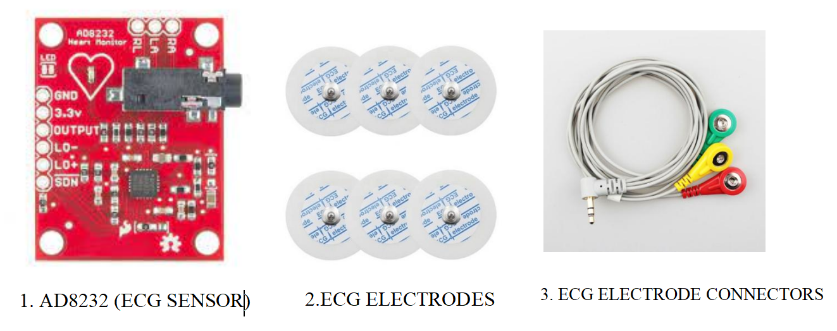
REAL TIME ECG SIGNAL EXTRACTION
Components Needed:
1. Arduino UNO
2. ECG sensor(AD8232)
3. ECG electrodes
4. ECG electrodes connectors
5. Power supply
6. Connecting wires
7. Software: Ardiuno IDE

Slide 20
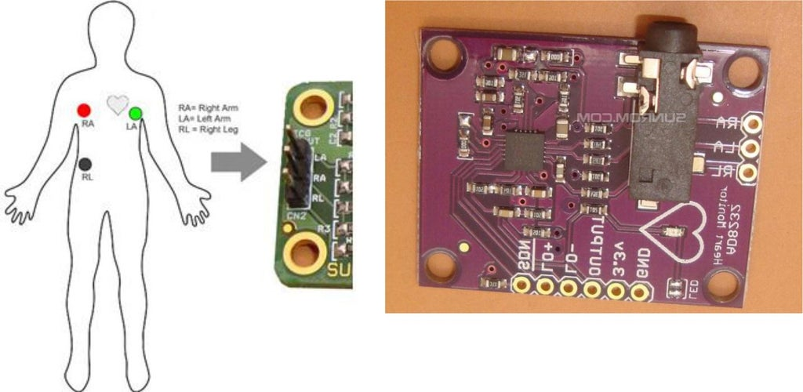
AD8232 Pins
RA - Input 1
LA - Input 2
RL - Input 3

Slide 21
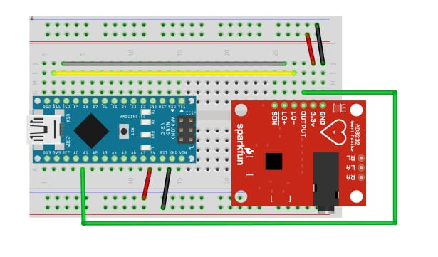
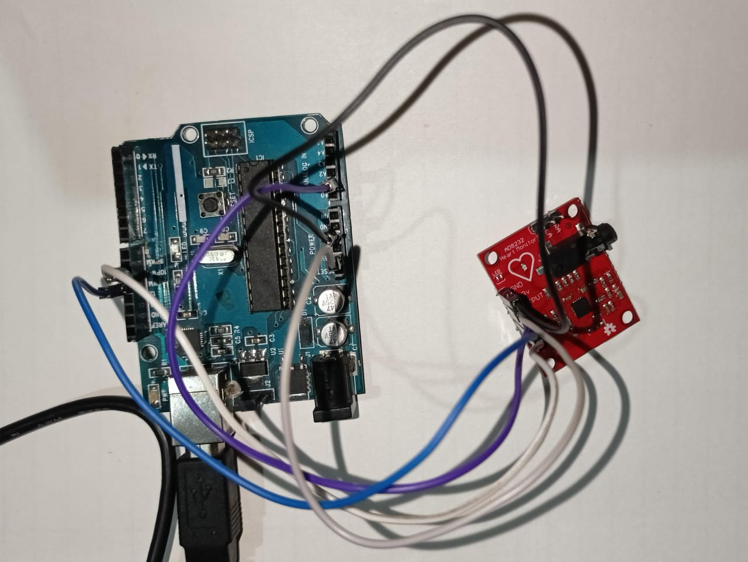
HARDWARE SET-UP
SCHEMATIC DIAGRAM
HARDWARE SETUP

Slide 22
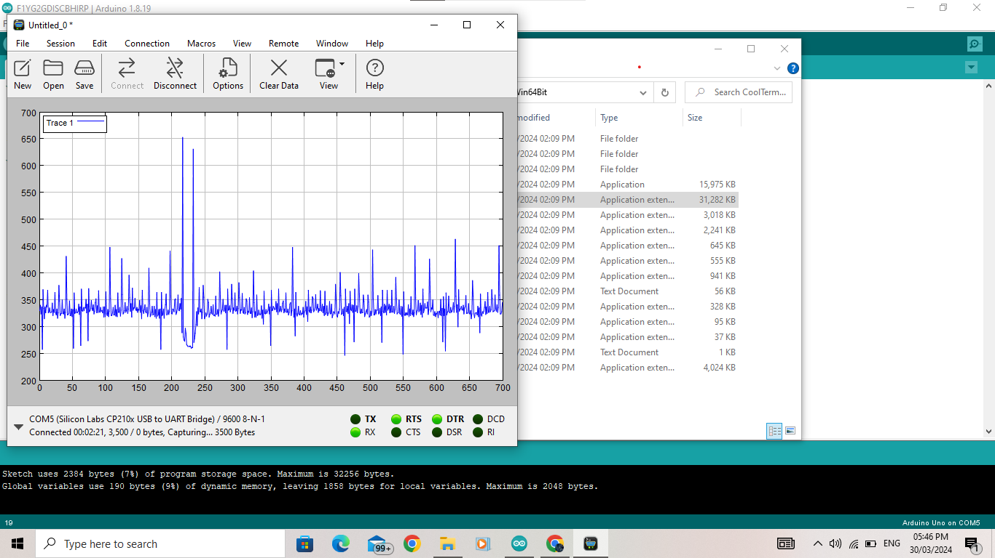
REAL – TIME ECG

Slide 23
OUTPUTS & RESULTS

Slide 24
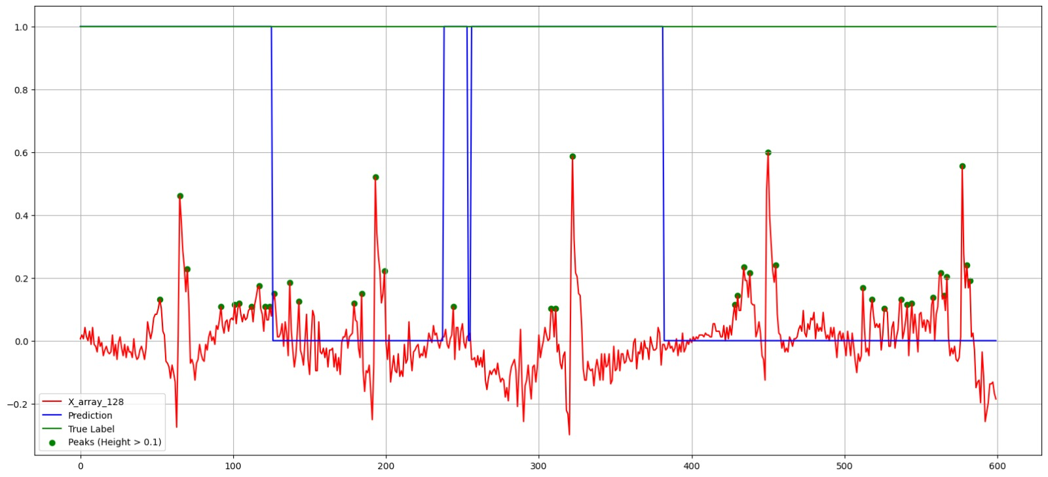

OUTPUT
AF Detection in Long-term AF Dataset:
Display of AF Detection in Long-term AF Dataset:

Slide 25
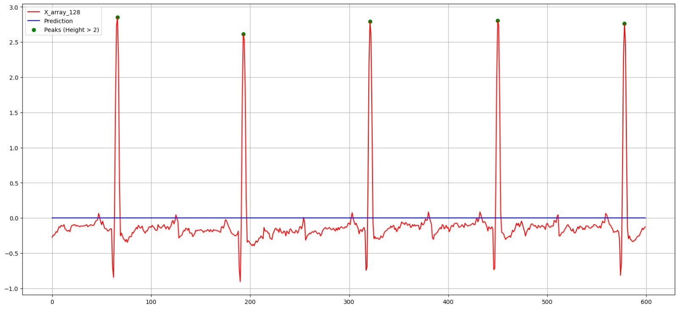

OUTPUT
AF Detection in Normal Sinus Rhythm Dataset:
AF Detection in Normal Sinus Rhythm Dataset
Display of AF Detection in Normal Sinus Rhythm Dataset:

Slide 26
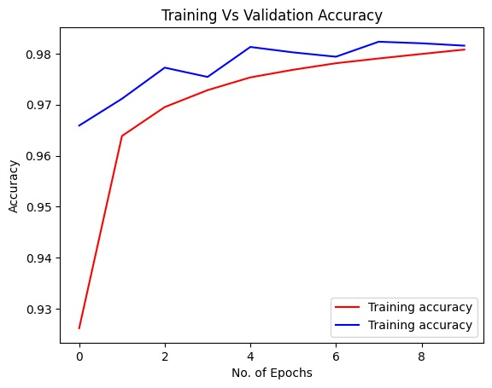
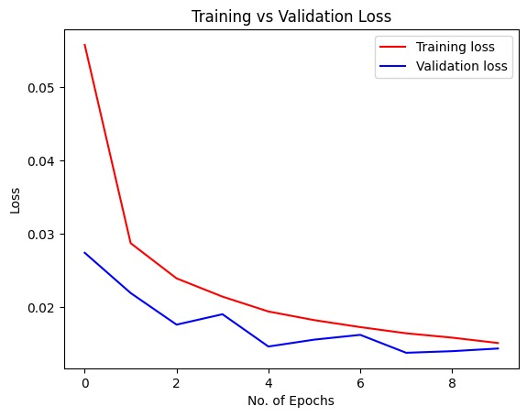
RESULTS
Training Accuracy vs Validation Accuracy
Training Loss vs Validation Loss

Slide 27
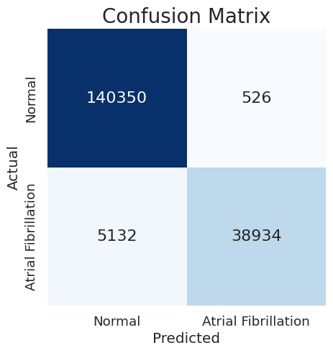
CONFUSION MATRIX:

Slide 28
PERFORMANCE METRICS:
Performance Metrics | Proposed Model
Accuracy | 96.5%
Precision | 0.966
Recall | 0.965
F1 Score | 0.964
Specificity | 0.996

Slide 29
COMPARISION WITH OTHER METHODS
Performance Metrics | Existing Methods |  |  |  | Proposed Method
 | CNN/LSTM | SVM, RF | 1D-CNN | DDCNN | CNN/U-Net model
Accuracy | 97.9% | 97.45% | 87.98% | 91% | 96.89%
Precision | - | - | - | - | 97%
Recall/Sensitivity | 97.8% | 98.99% | - | 78% | 96.9%
F1 Score | - | - | 0.84 | 0.83 | 0.969
Specificity | 0.97 | 0.95 | - | 0.901 | 0.996

Slide 30
THANK YOU!

